Slide 1

ALY 6980
CAPSTONE PROJECT
Group 3: Pei-Yu Jheng, Shreeya Ambre, Sean McLean, Ted Smith
26th March 2025

Slide 2

INTRODUCTION
This is a great exercise to have an open opportunity to see what we find
Areas to improve to pave the way for increased future successes
Allows Big Sky to focus on the most important factors bringing new clients

Slide 3

KEY QUESTIONS
FOCUS AREAS FOR CLIENT ACQUISITION
Our analysis will highlight key areas to focus on for landing more clients
STATE/REGION IMPACT
Do certain states or regions influence the number of inquiries and probabilities in the dataset?​
​

Slide 4
BLUE SKY FRANCHISE/OTHER FRANCHISES
Blue Sky has used blogs since 2016 as well as having a steady YouTube and podcast presence online.
Emphasis on these digital tools could impact future leads and deals.
Digital presence can also affect regional and national sales.
Other Franchises like Franchise Creator focus on faster timelines, lower costs, more locations regionally and nationally.
Another franchise called Franchise Maker offers pay as you go programs, no hidden agendas, and like Blue Sky a three-step program to its clients.

Slide 5



DATA PREPARATION
Data Cleanup
Dashboarding
Analysis

Slide 6
DATA CLEANUP PROCESS
Duplicate Columns: Identify and distinguish 14% duplicate columns.​
Removed 33% of columns (id, pipeline) due to redundancy or repetitive patterns.​
Handle Missing values improving completeness by 28%.
Importing Data
Merging Datasets
Rebuilding Missing Data
Deduplication
Standardization

Slide 7
DATA ANALYSIS
Identify Trends and Patterns
Comparison with External Datasets
Examine Variable Relationships
Focus on key attributes to target potential clients
Evaluate similar external datasets for added insights
Examine correlations for business insights and addressing concerns

Slide 8
DATA GOVERNANCE
Data Quality
Data Stewardship
Data Protection
Data Management

Slide 9








Slide 10
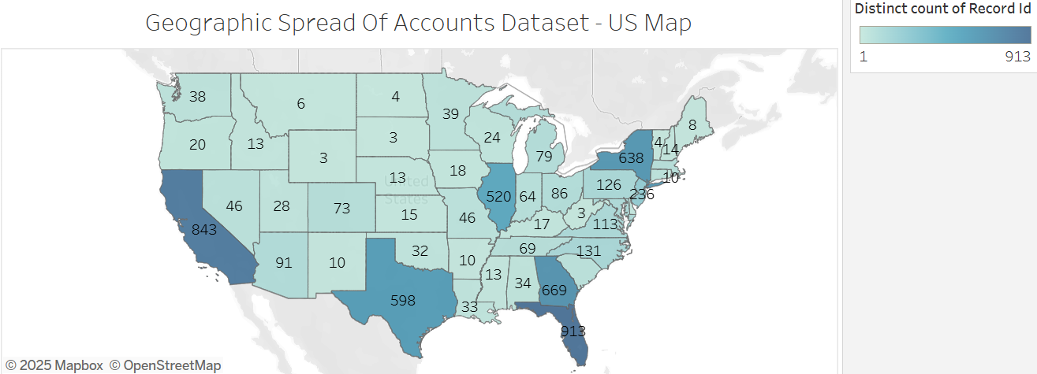

Slide 11
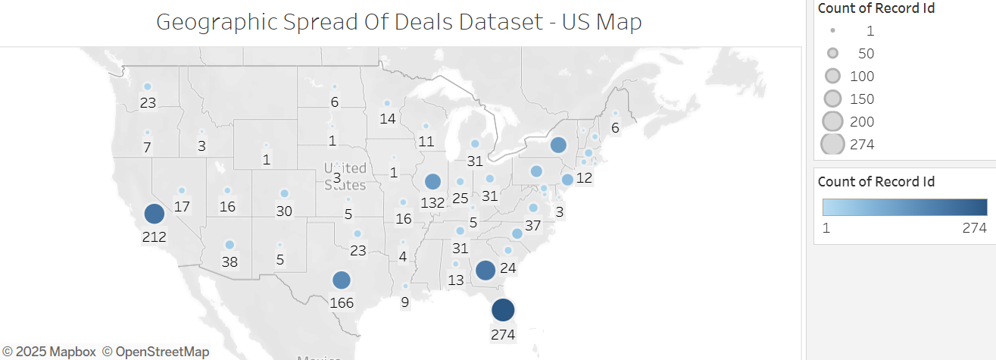

Slide 12
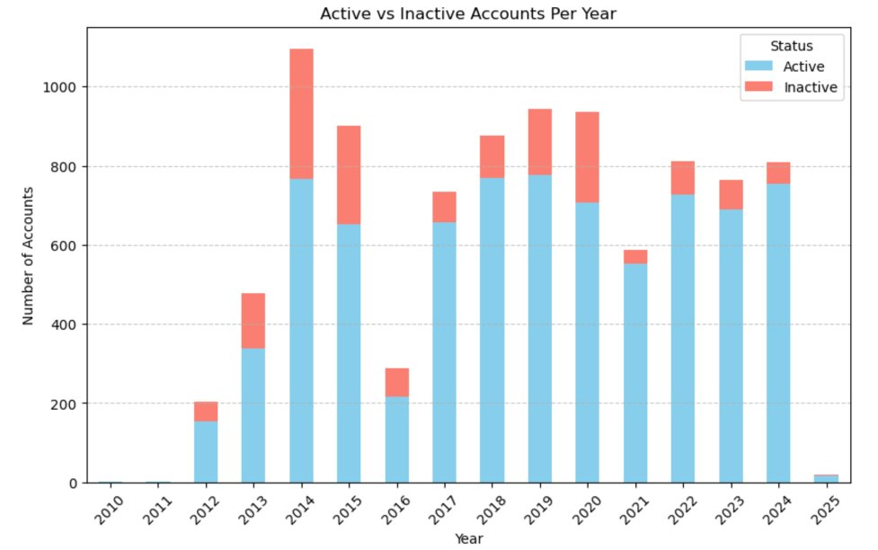
Account Status
To preparing the data for analyzing,
Define Active and Inactive categories​; for example, dead stage of the accounts label as inactive; client - active stage label as active.
Find the actual year from lead_recived column​
Group by 'created_year' and 'status_category' and count the occurrences​
Answer: How many accounts staying and leaving each year?

Slide 13
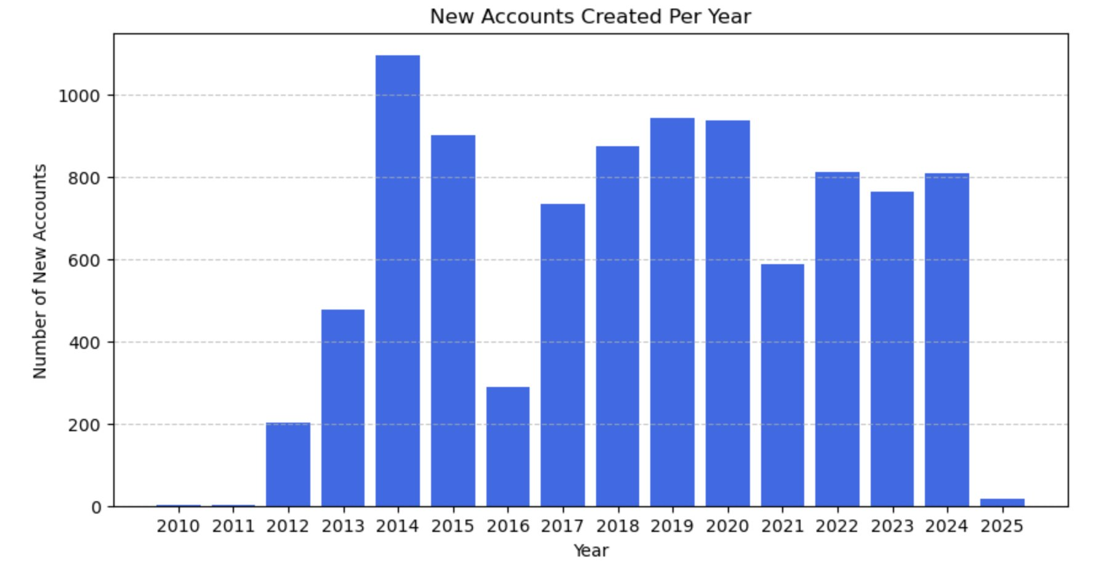
New Accounts
This chart showing how many new customers added into big sky CRM database each year
Many will have the same date due to an import date from a previous CRM system.​ Find the actual year for new accounts created date from lead_recived column
Before 2016, the data went up and down significantly; however the data were getting stable since 2017 to 2024, big sky has about 600 to 800 new accounts each year

Slide 14
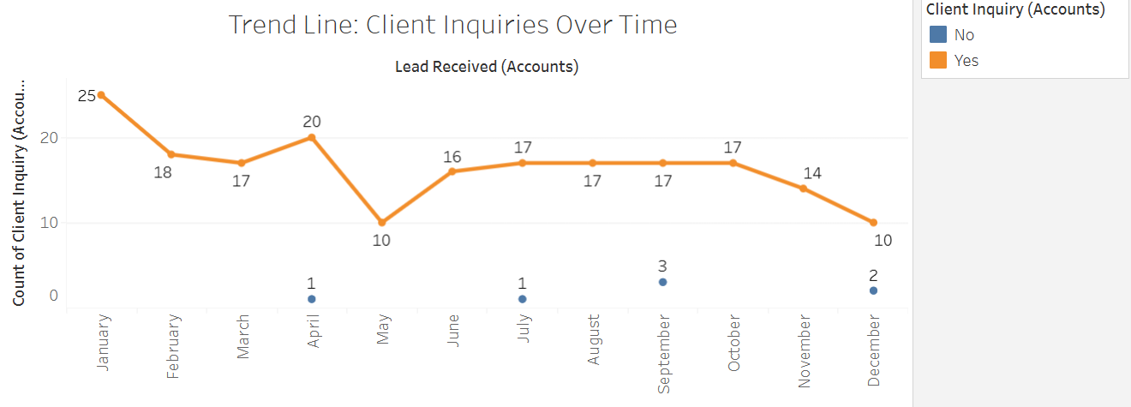

Slide 15
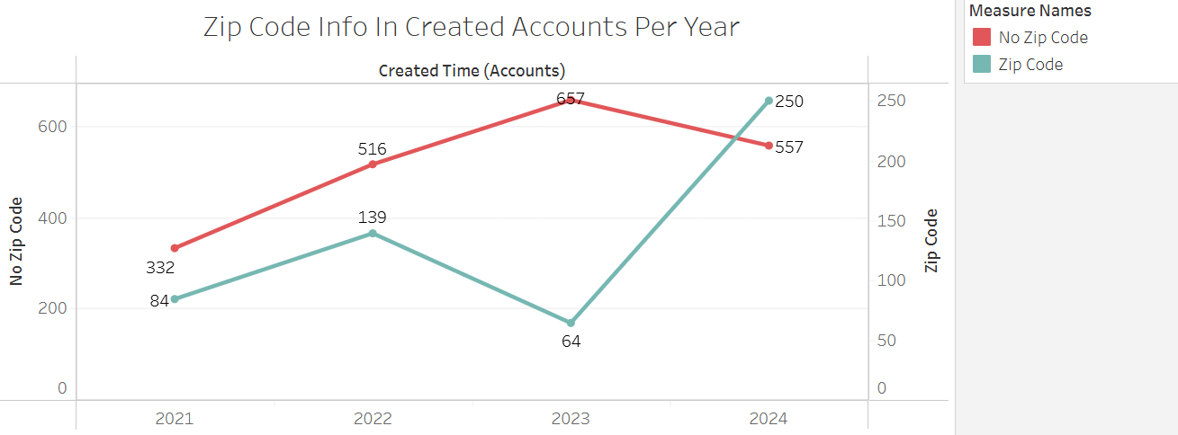
Improvements in obtaining zip code information from 2023 to 2024.
Important for account follow-ups as well as parts of the country to consider in terms of sales?

Slide 16
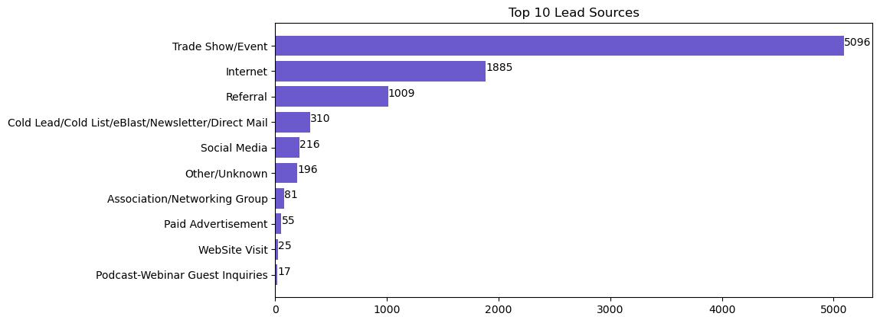
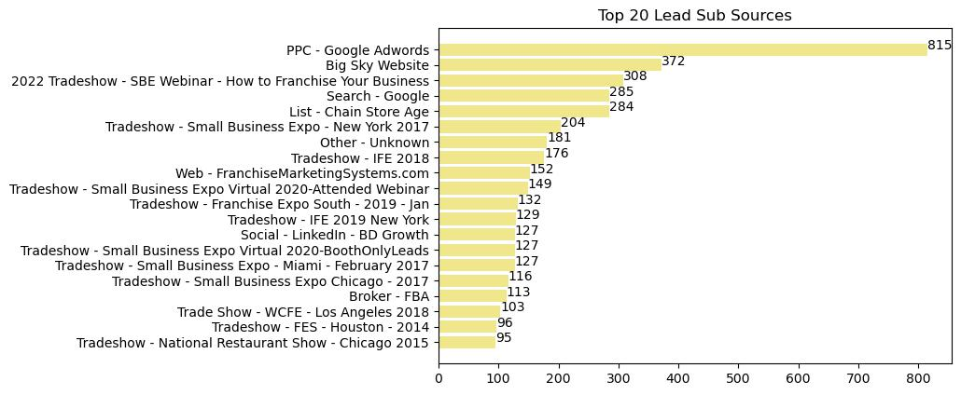
Lead Sources

Slide 17
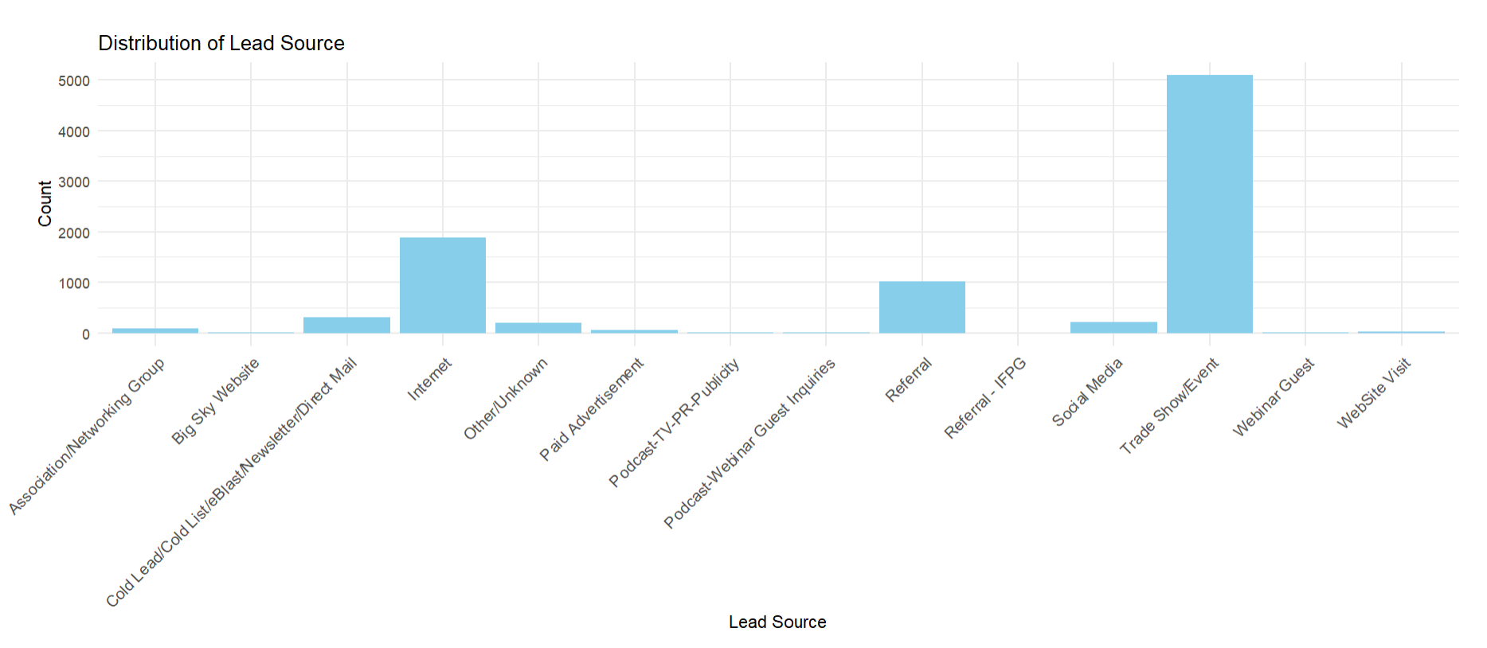
Most common lead sources are trade show/event, internet, and referrals.
Paid advertisements have the highest suspension probability rates.

Slide 18
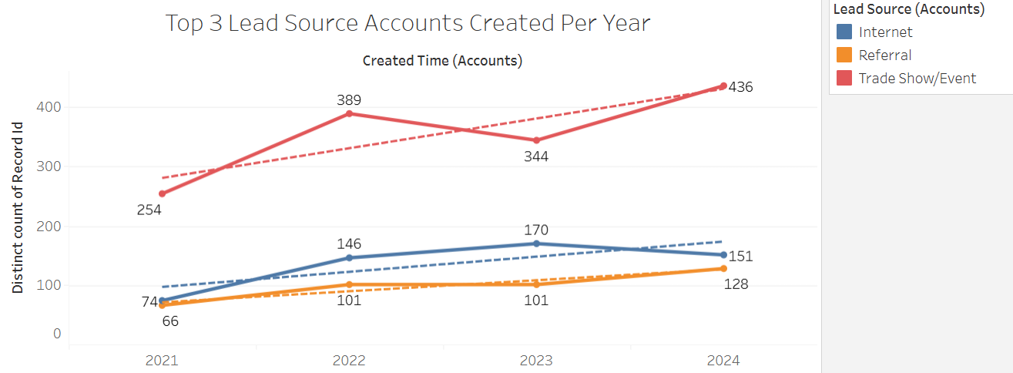

Slide 19
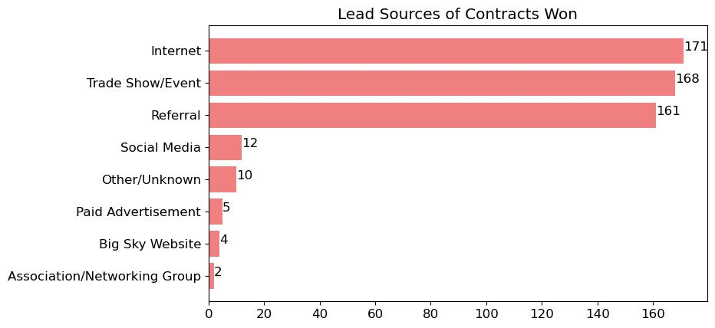
Focus on the Success
We are going to start from focus on Big Sky’s success, about which lead source has the most customers who have successful transactions with Big Sky?
They are mainly from internet, trade show/event, and referral

Slide 20
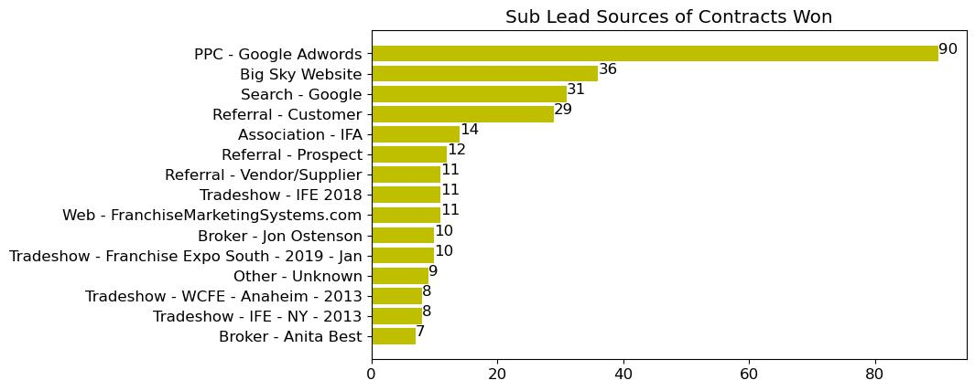
Focus on the Success
We also breaks down the details in the sub leads:
The top 5 events attract deals success customers are Google Adwords, Big Sky Website, Google Search, Referral - Customer, and International Franchise Association

Slide 21
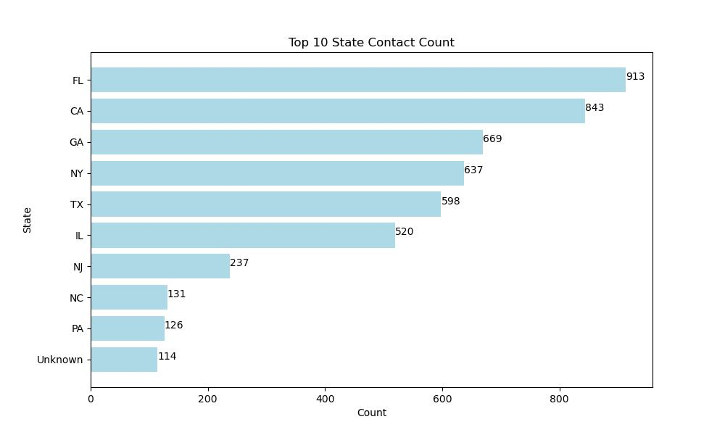
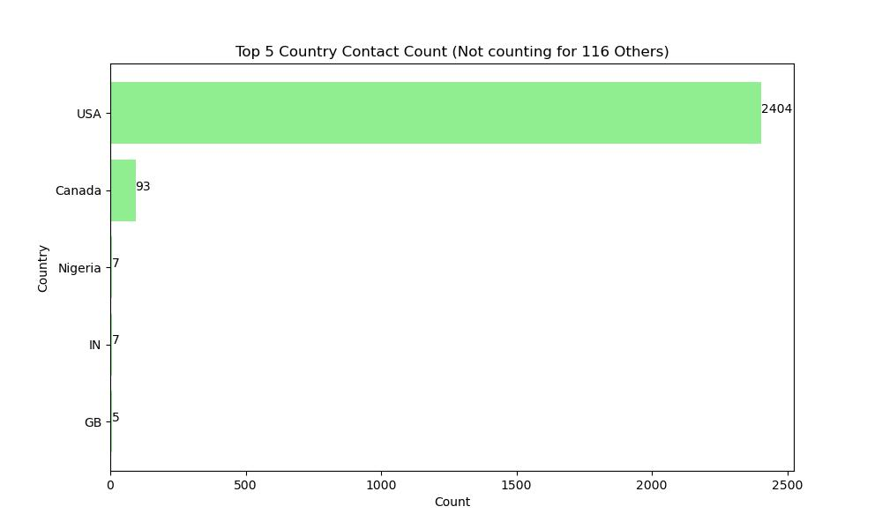
Leads and Contacts
Notes:
Next where are Big Sky customers from

Slide 22
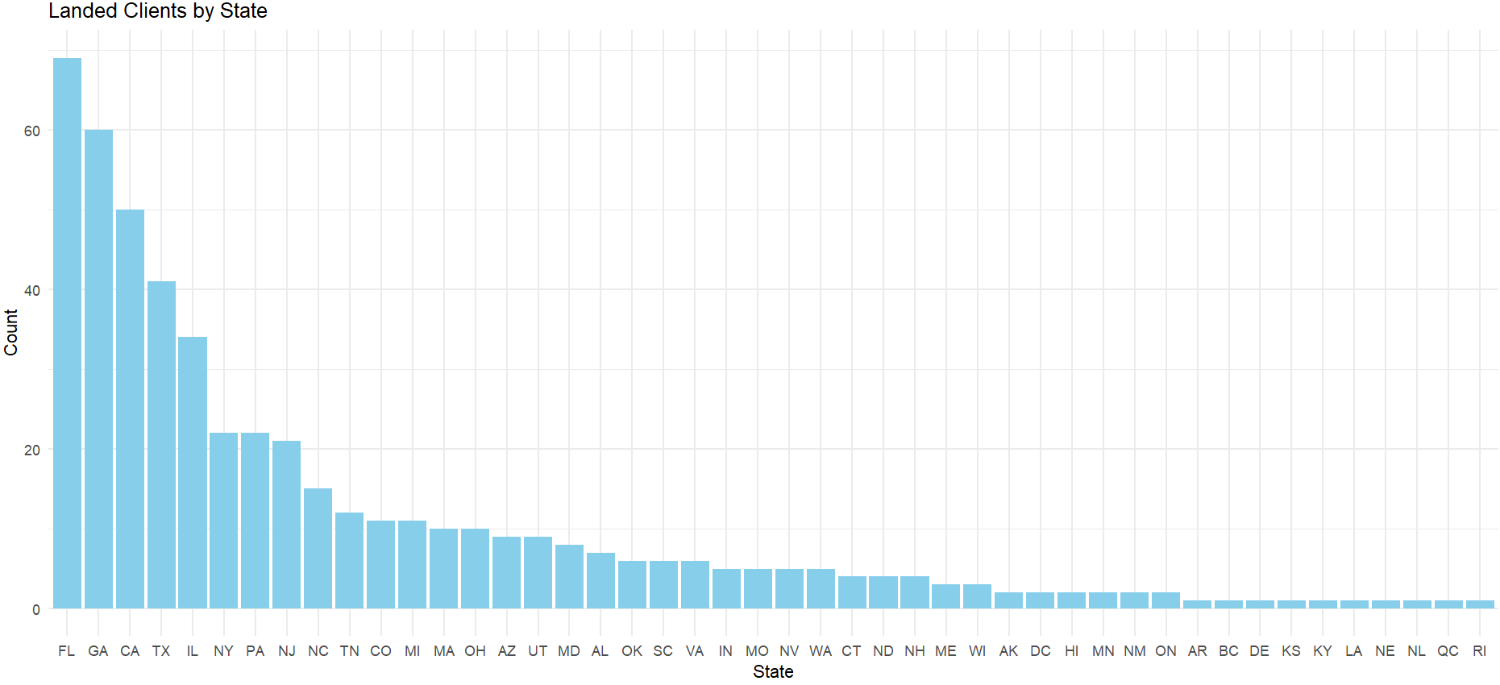
MOST CLIENTS PER STATE FROM DEALS DATASET

Slide 23
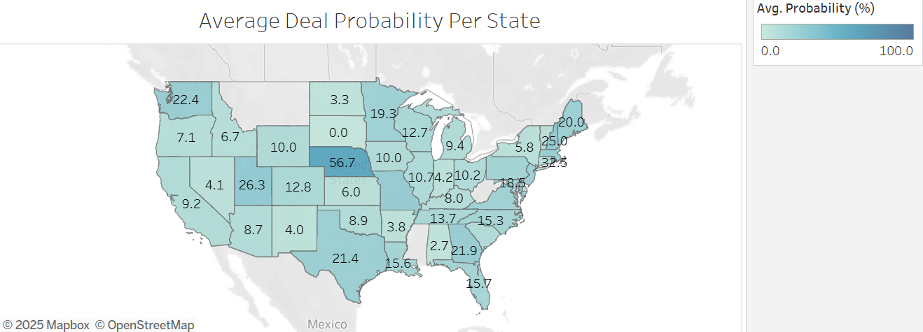
WHERE DEALS ARE MOST EFFECTIVE NATIONALLY
Higher probability rates in Nebraska, Utah, and Washington.
No regional clusters impacting deal rates.
-Top 5 states by total clients (Florida, Georgia, Texas, California, and Illinois) have high to moderate deal probabilities.
-Some states have high deal probabilities but have small sample sizes.
-Clusters of high to moderate deal probabilities in the Midwest, South, and Northeast.

Slide 24
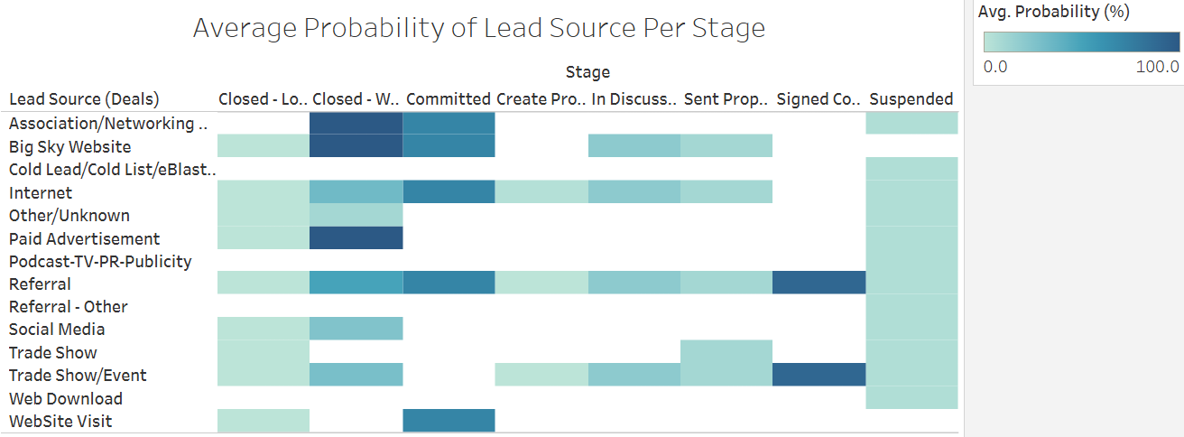
WHICH LEAD SOURCES PROGRESS THE MOST?
- Internet, Trade Shows, and Referral all go through each stage and have moderate to high closing probabilities.
- Big Sky Website has high commitment and closing rates.
- All podcasting and cold leads sources lead to suspensions.
- Other website visits have high commitment rates but don’t lead to closing deals.

Slide 25
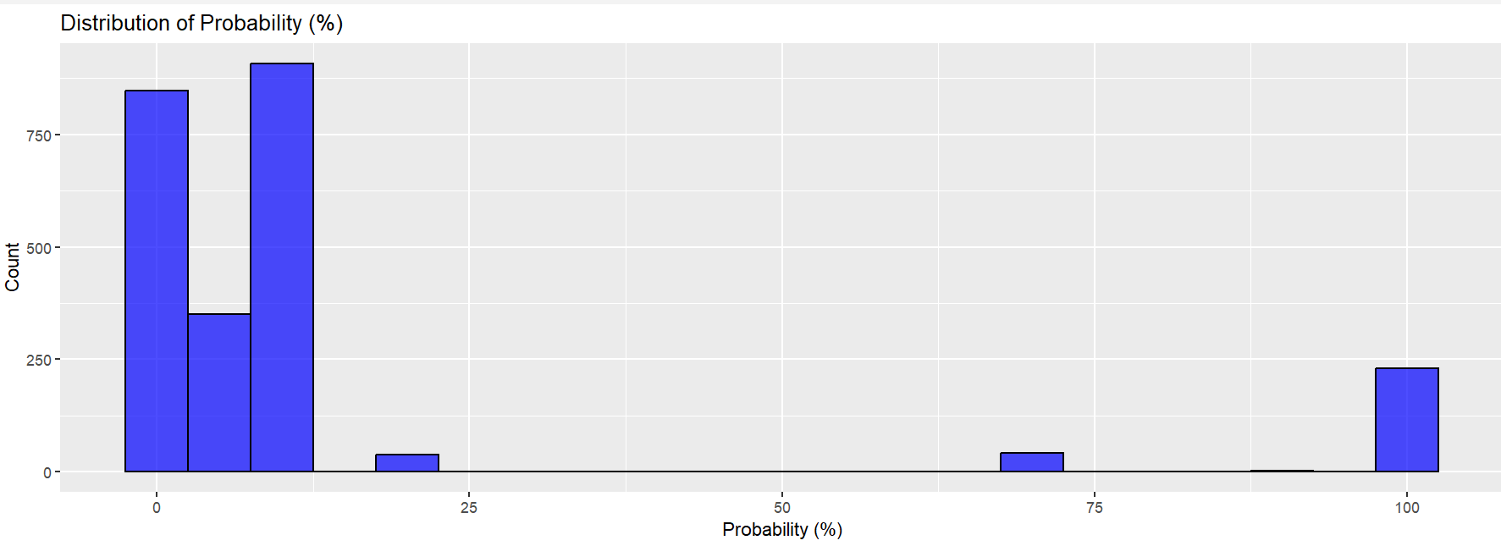
DISTRIBUTION OF DEAL PROBABILITY PERCENTAGES

Slide 26
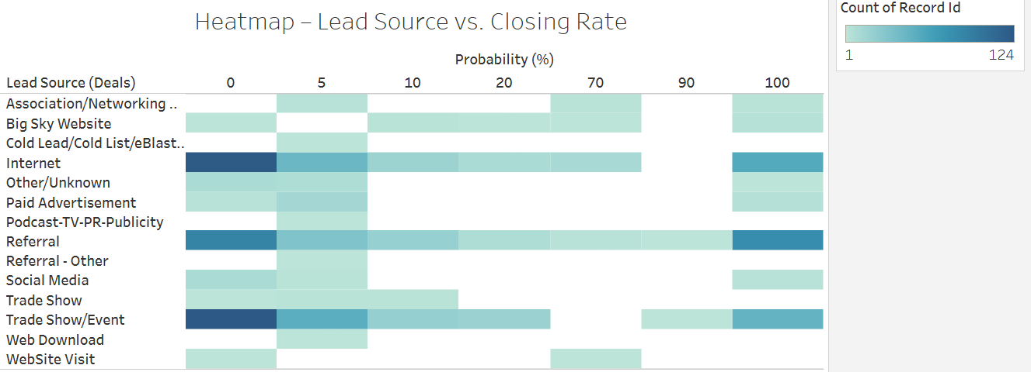

Slide 27
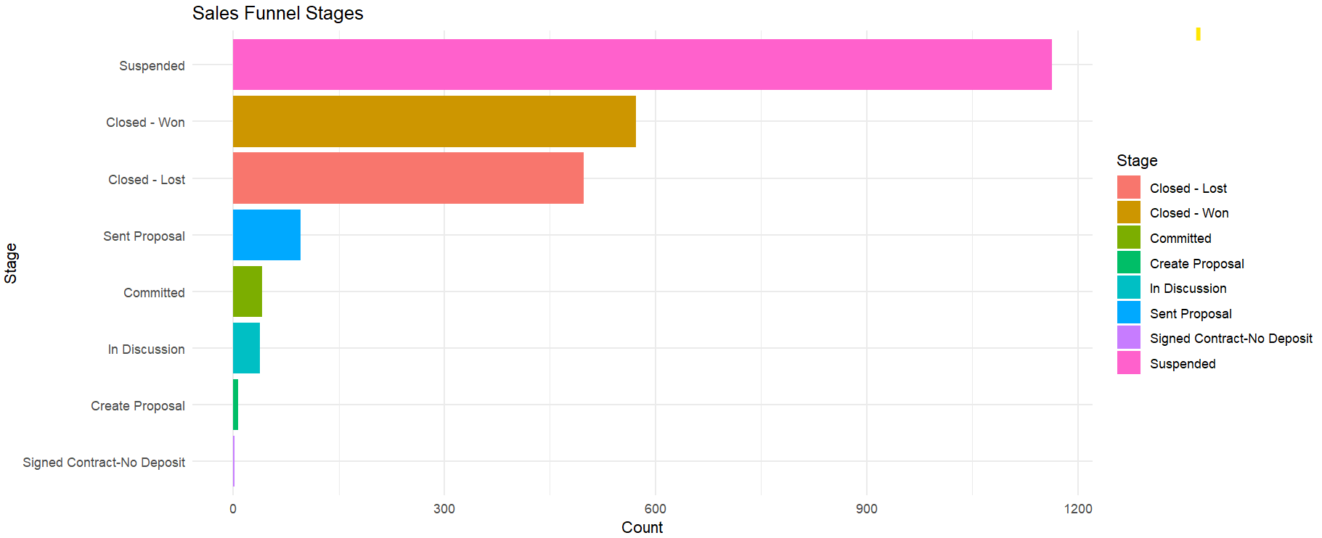
SALES FUNNEL STAGES

Slide 28
SALES FUNNEL STAGES (CONT.)
Average sales cycle duration: 79.84 Days
Top Lead Sources by average sales cycle:
Referral: 56 clients, 28.7 average sales cycle duration
Internet: 48 clients, 49.8 average sales cycle duration
Trade Show/Event: 38 clients, 45.8 average sales cycle duration
Question to consider from graph: How can Big Sky prevent deals and proposals from being suspended?
Average time between proposal sent and closing date is 53.85 days. Does time impact suspension rates?

Slide 29
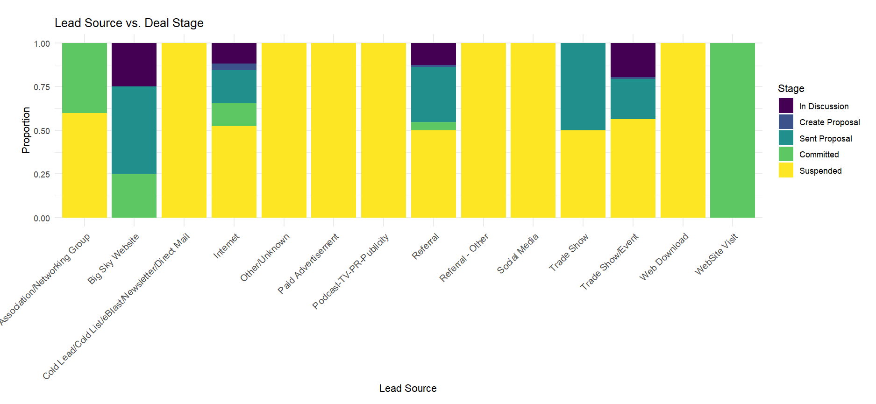
LEAD SOURCE VERSUS DEAL STAGES
The Lead source effectiveness varies dramatically across Big Sky’s sales pipeline
The Big Sky website stands out as the most effective channel with No suspensions & high commitment rates
Several lead sources have 100 % suspension rates, indicating these channels aren't progressing deals forward
The priorities should be focus on lead sources that work in the future and how to improve closing rates for lead sources that are getting past suspensions.

Slide 30
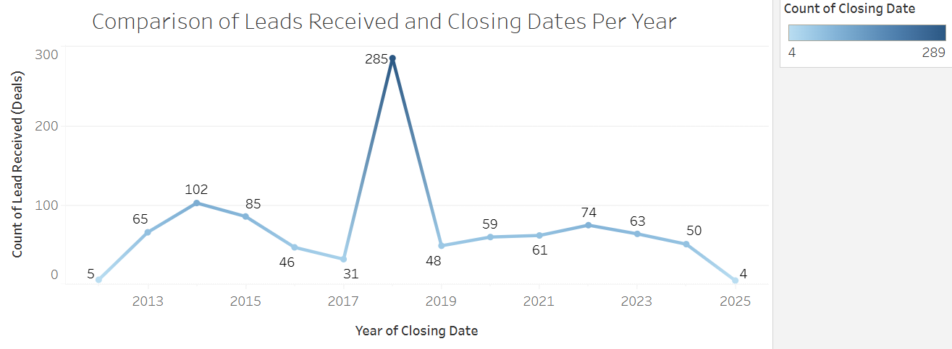
PRODUCT OVERVIEW
First beautifully designed product that's both stylish and functional
What can we learn from 2018 in regard to leads being received followed by closing the deals?

Slide 31
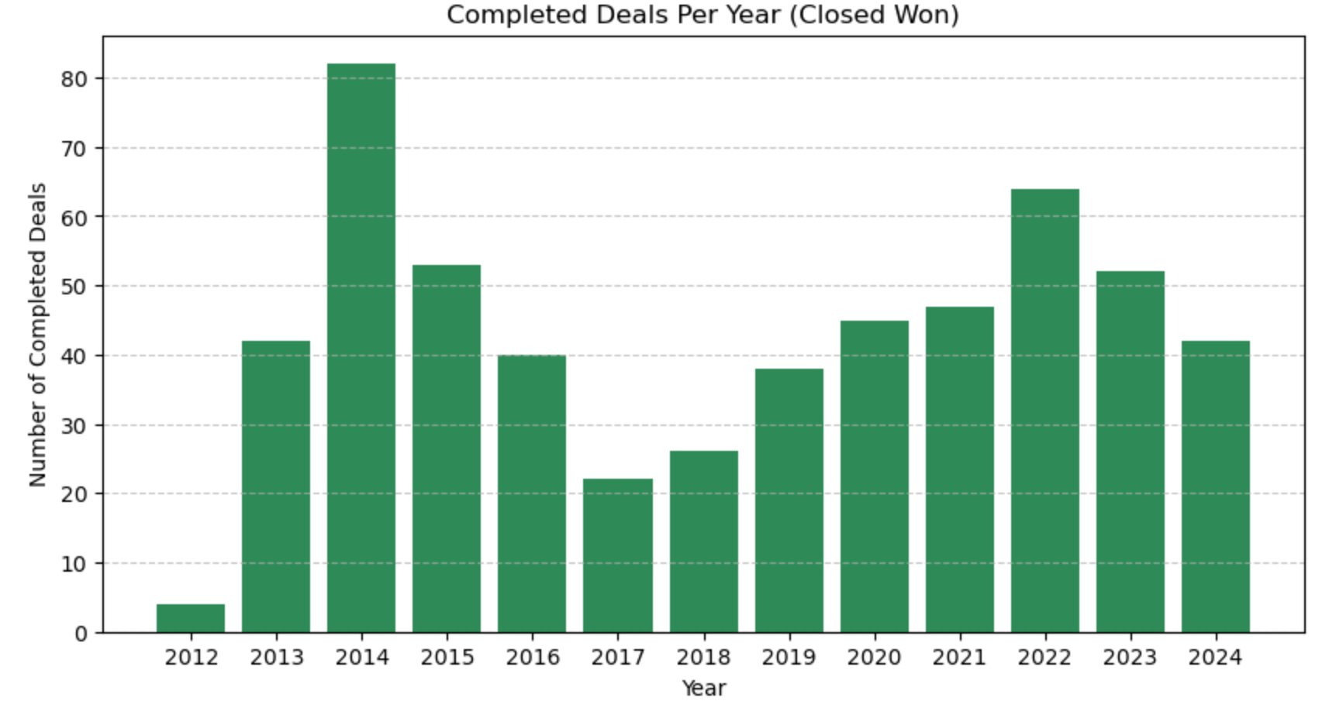
Deals Completed
Filter for 'closed_won' deals in the 'stage' column​ and find the actual date from lead_recived column
2014 reached the highest succeed deals in the history.
The sales are growthing from 2018 to 2022. 2022 has more than 60 cases won.
The overall trend keep growing in the last five year has more than 40 deals each year.

Slide 32
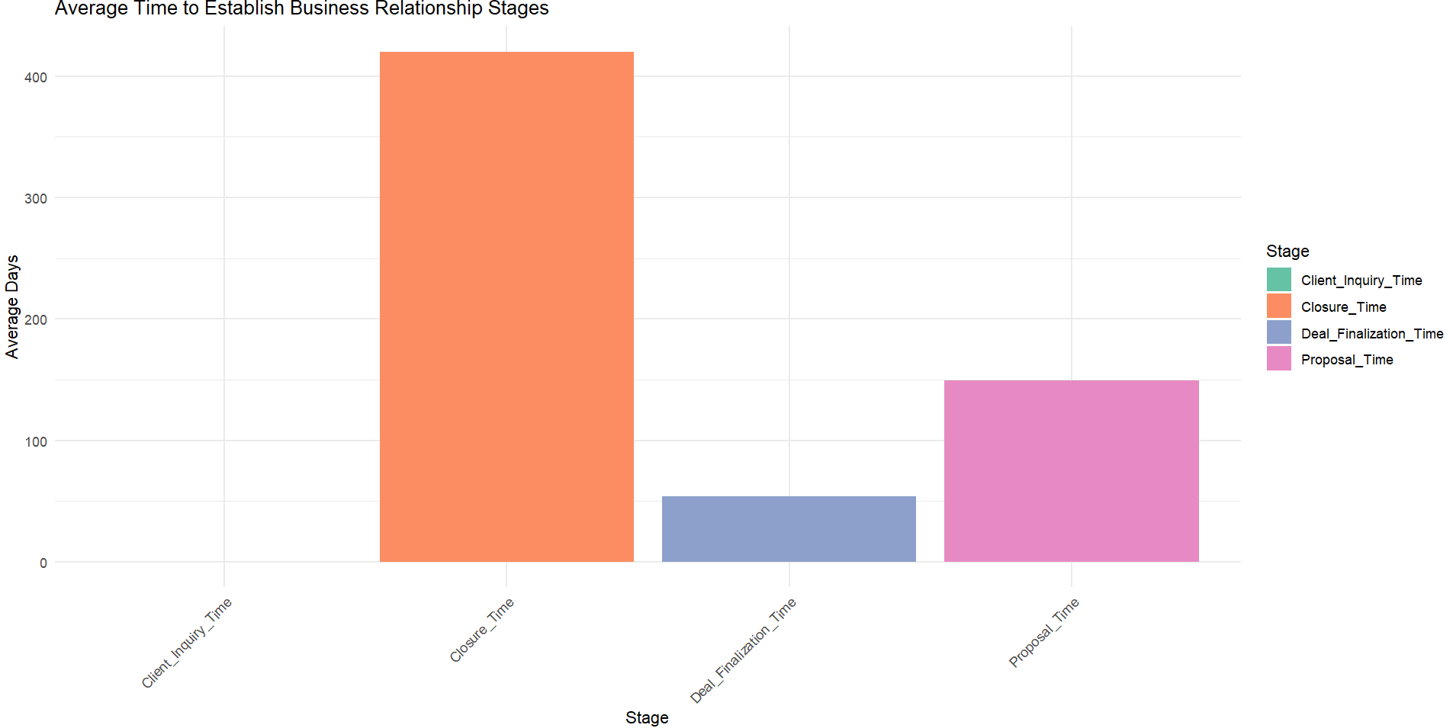
HOW LONG DOES IT TAKE TO ESTABLISH RELATIONSHIPS?

Slide 33
DISTRIBUTION OF DEAL PROBABILITY PERCENTAGES (CONT.)
Average response time from lead received to closing date is 420 days.
Average time from the lead being received to the proposal sent date is 150 days.
Average time from the proposal sent date to the closing date is 52 days.
Question: Is there other steps in the deal process that make up for the other days not included in the averages between the three main stages?

Slide 34
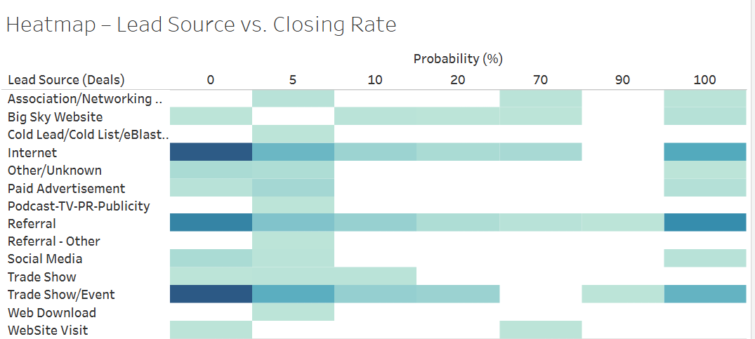
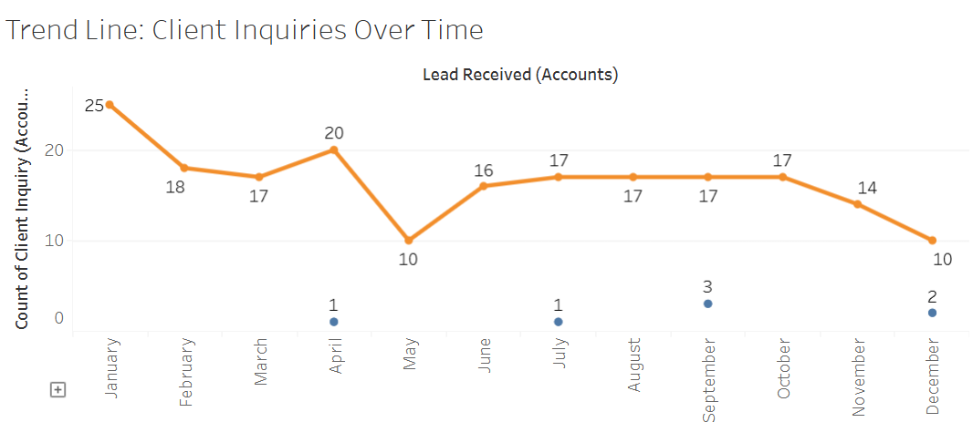
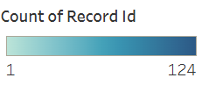
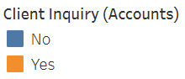
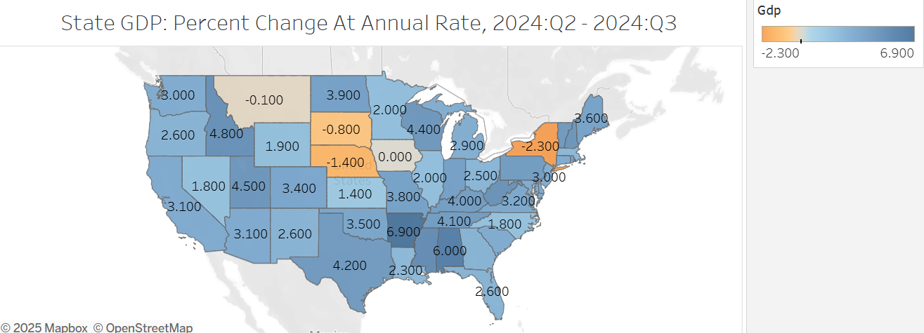
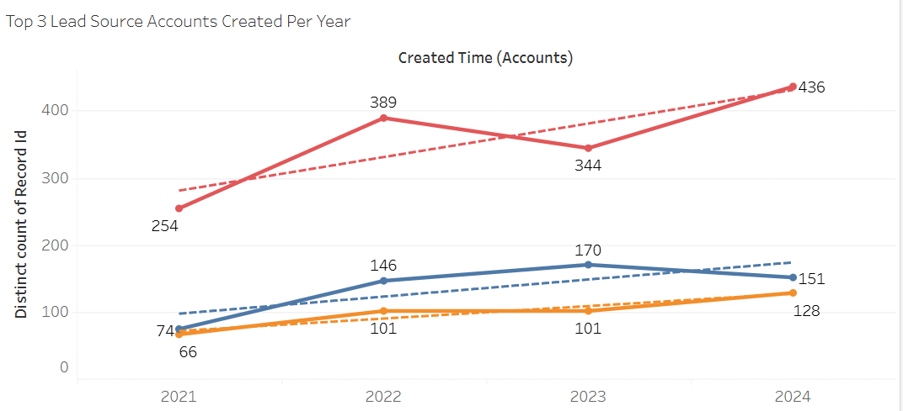
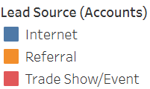

Slide 35
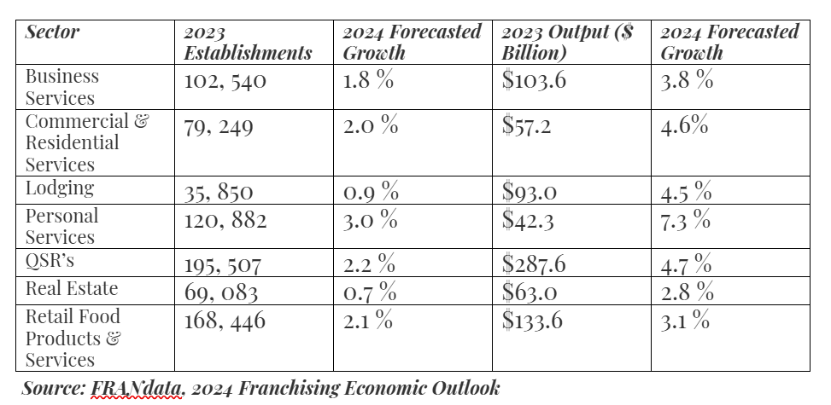
FRANCHISING OVERVIEW
2.2 % Overall Growth in franchising industry despite concerns over inflation and supply chain disruptions.
2024 Forecasted Growth shows overall increases in total establishments (1.9 %) and total franchise output (4.1 %).
Key sectors in 2024 predictions that have been impacted by consumer behaviors include personal services, quick service restaurants, and commercial & residential services. (Barraan, J, 2024).

Slide 36
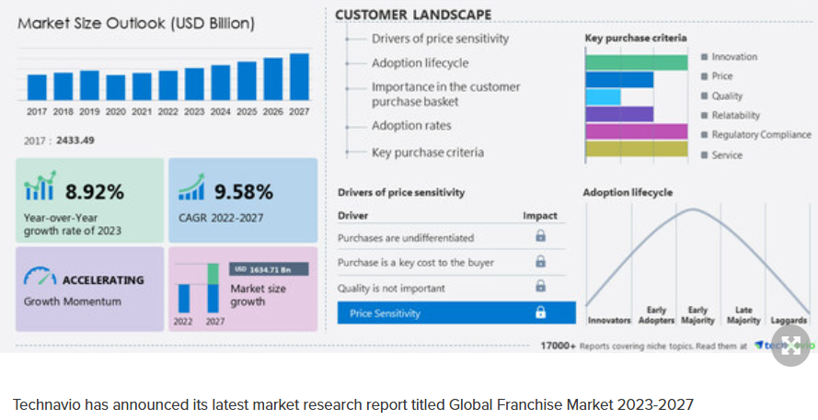
GLOBAL FRANCHISE MARKET: 2023-2027
Increases in year-to-year growth rates and compound annual growth rate (CAGR) over the next few years.
Main driver of the franchising sector is an increase in construction activities.
Enhancements in in-store retailing has become popular in franchising markets.
Challenges include brand quality, operational costs, and employee turnover rates. (Technavio, 2023).

Slide 37
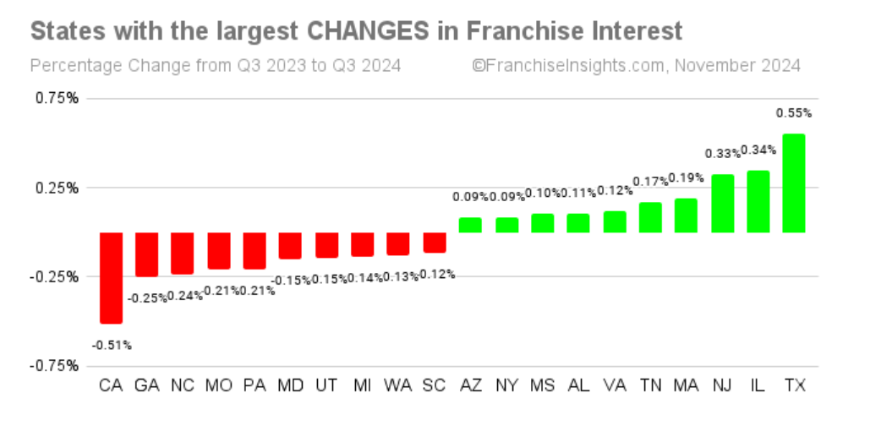
FRANCHISE INTEREST SHARE SHIFTS PER STATE FROM Q3 TO Q4: 2024
Highest rate changes among the states are Texas, Illinois, and New Jersey while California has the biggest loss.
Metrics based off franchisee searches which is usually where they reside.
Weather events like Hurricane Helene and regional wildfires could have potentially impacted certain states performance in Georgia, North Carolina, and California. (Franchise Insights, 2024).

Slide 38
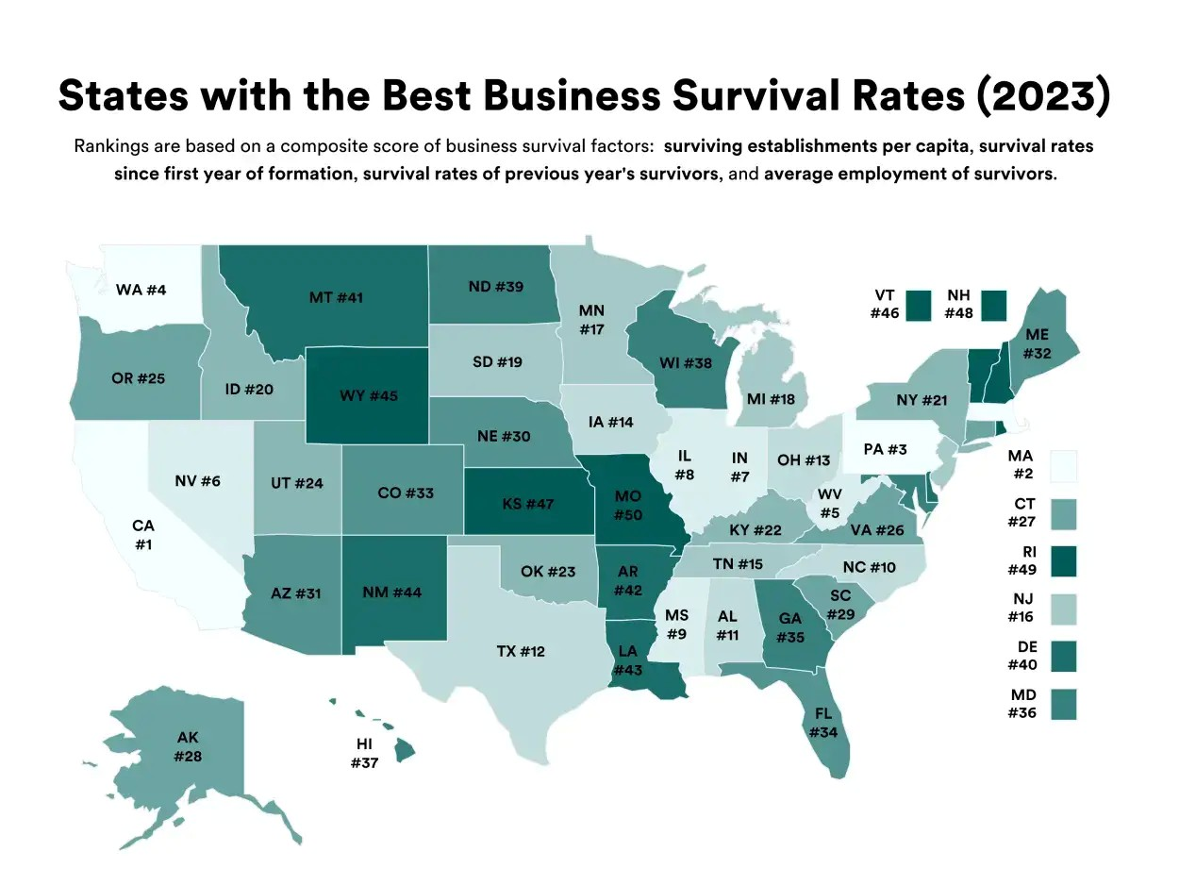
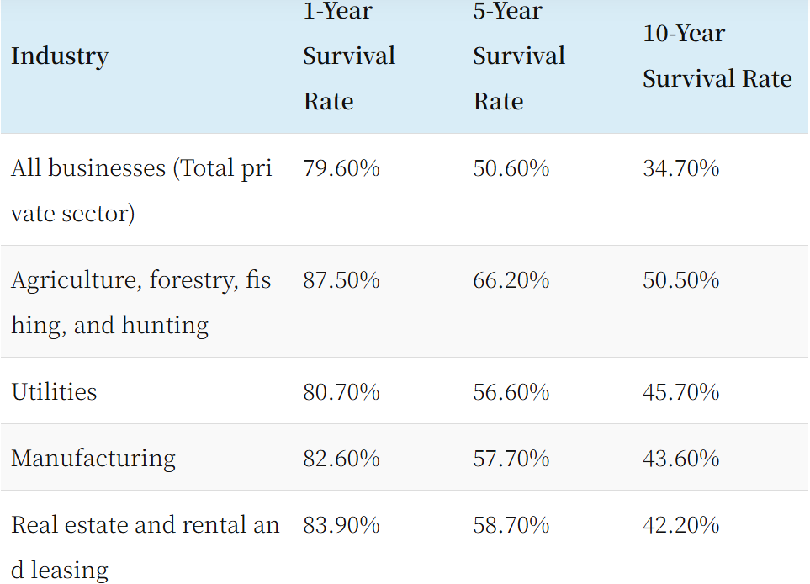
TOP FAILURE RATES OF SMALL BUSINESSES BY INDUSTRY
Reference: Bawden-Davis, Trademark Engine (2023).
Reference: Commerce Institute (2024).

Slide 39
Stronger regions in the southeast, especially in Alabama, Arkansas, and Tennessee.
Parts of the Midwest and New York show negative returns for the quarter.
How can these recent numbers affect approaches toward franchising deals in the future?
In economics, Gross Domestic Product (GDP) is the total monetary value of all final goods and services produced within a country's borders during a specific period, typically a year, and is a key indicator of a nation's economic health.
Franchising significantly impacts the economy by supporting GDP through billions in products, services, and payroll, creating jobs, and contributing to local economies through tax revenue and community involvement.

Slide 40
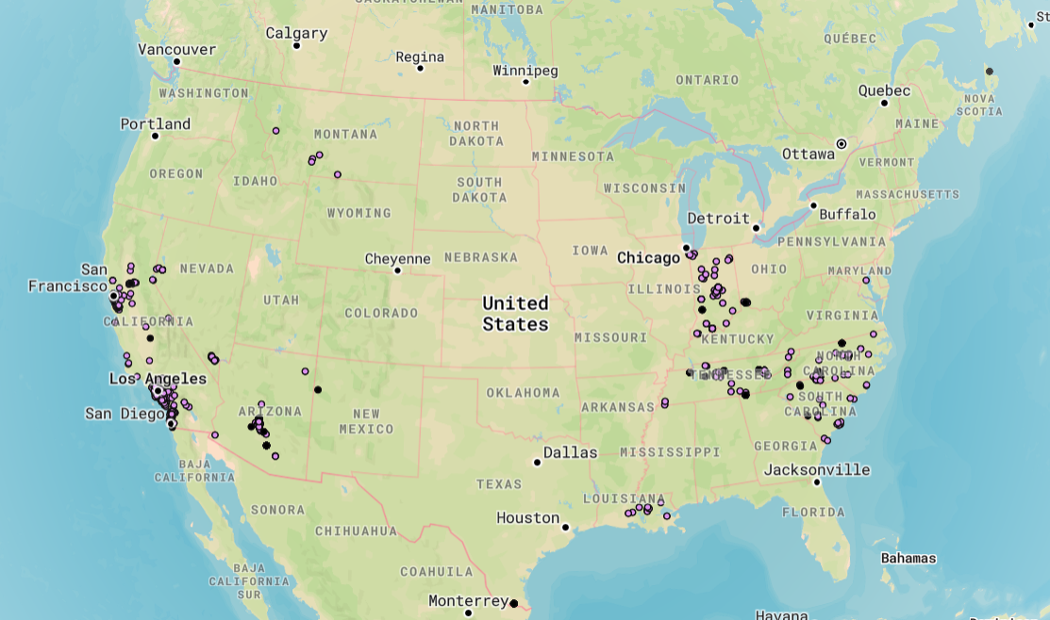
NEW CUSTOMER TYPES IN ACCOUNTS BY STATE USING MAPBOX PROGRAM
Black points show accounts with no new customer types and purple points contain a new customer type.
Map shows clusters of the accounts in California and Arizona, Indiana, and the Carolina's in the southeast.
Bigger markets with new customer types presence include San Francisco, Lost Angeles, and Charlotte.

Slide 41
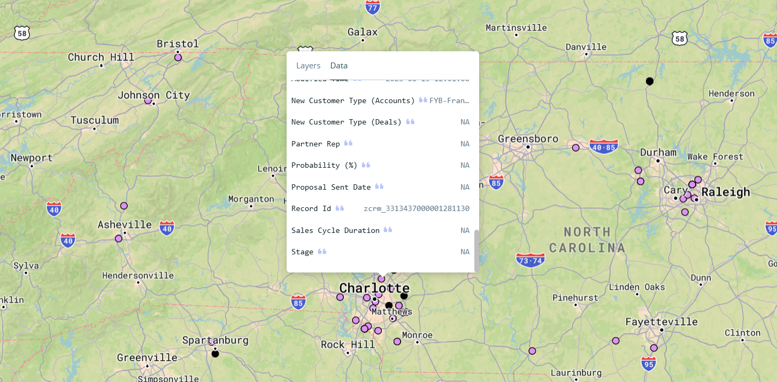
NEW CUSTOMER TYPES IN ACCOUNTS BY STATE USING MAPBOX PROGRAM (CONT.)
Program features include dataset information on each point on map that is selected.
Tool for franchises to find potential markets and client trends from utilizing past data.

Slide 42
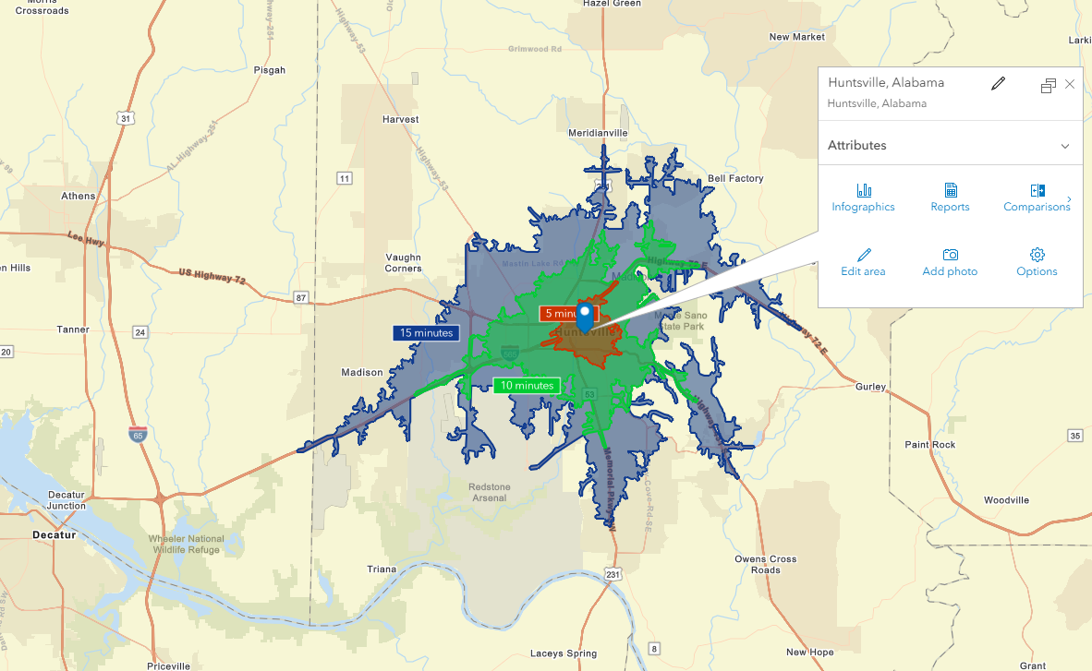
Huntsville, AL
This slide and the following slides are from the Business Analyst app which is an additional feature available on ArcGIS.

Slide 43
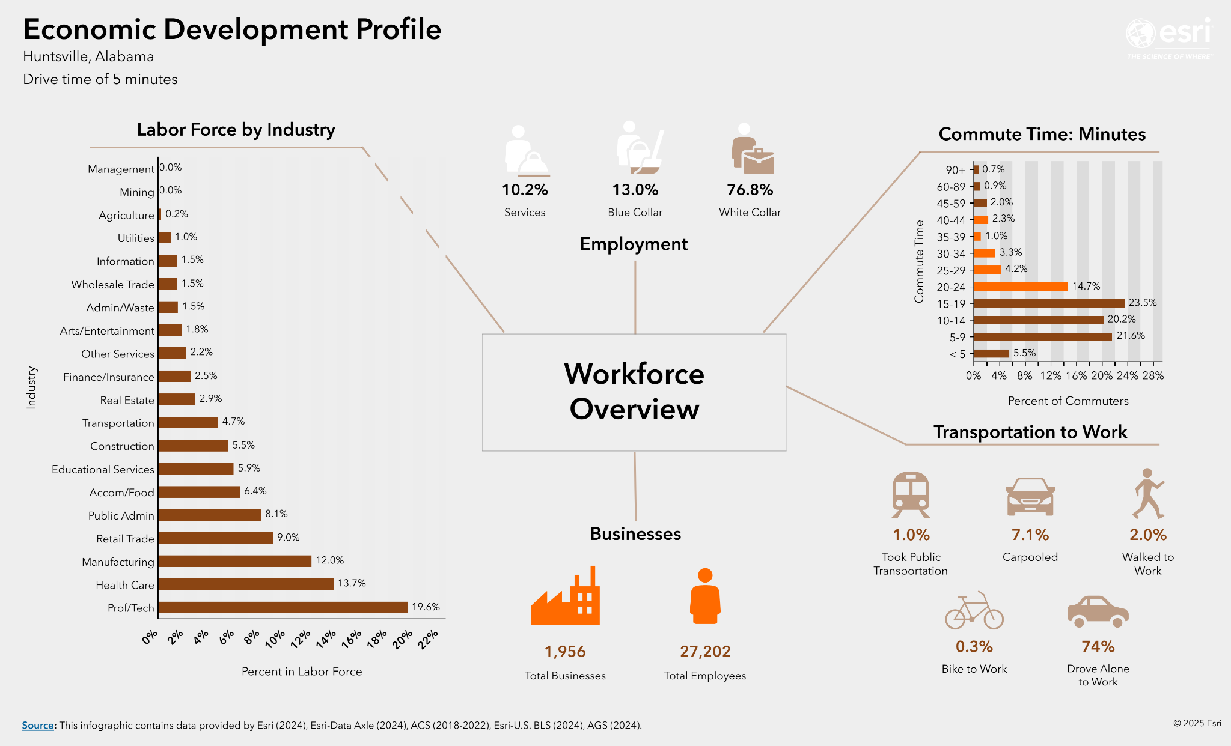

Slide 44
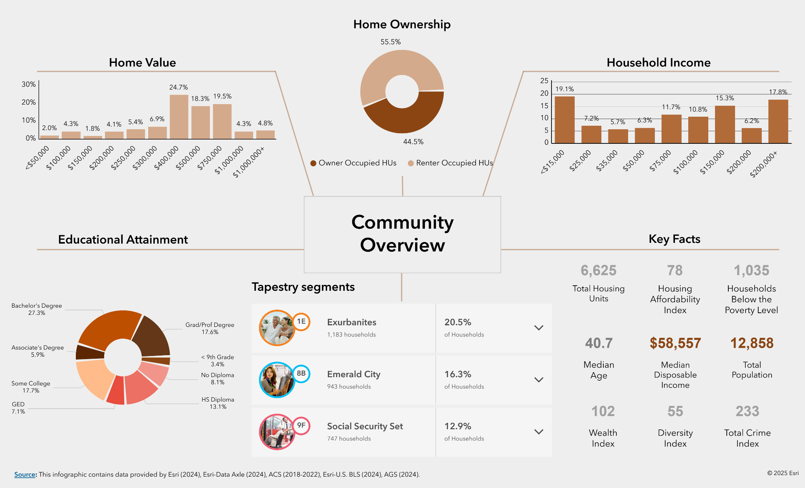

Slide 45

NEXT STEPS/RECOMMENDATIONS
Look at how the most effective lead sources can impact client inquiries.
Evaluate how different regions and states can affect long-term growth.
Opportunity to improve internal processes.
Implementation of Data Governance.
The rise of new leads.

Slide 46
NEXT STEPS
Designing Customer Management Accounts
Data Collection methods to gain important metrics
Creating interactive dashboards for data insights
Presenting a plan and solution for long term growth
01
02
03
04

Slide 47
CONCLUDING THOUGHTS
Opportunity to improve internal processes
Implementation of Data Governance
Forward-focus
The rise of new leads
+
+
=

Slide 48

Thank You!

Slide 49
REFERENCES
Barraan, J. (2024, Apr. 18th). U.S Franchising Statistics Report: 2023 Recap and 2024 Forecast. Franchise Clues. https://www.franchiseclues.com/statistics
Technavio (2023, Oct. 12th). Franchising Market size to increase by USD 1,634.71 bilion during 2022-2027, Increasing construction activities to drive the growth – Technavio. Technavio. https://www.prnewswire.com/news-releases/franchise-market-size-to-increase-by-usd-1-634-71-billion-during-2022-2027--increasing-construction-activities-to-drive-the-growth---technavio-301953871.html
Alston, M. (2024, Nov. 20th). Texas, Illinois and New Jersey Gain the Most In Franchise Interest as California Decreases. Franchise Insights. https://www.franchiseinsights.com/franchise-prospects/texas-illinois-and-new-jersey-gain-the-most-in-franchise-interest-as-california-decreases/
Bawden-Davis, J. (2023, Oct. 27th). States with the Best Business Survival Rates. Trademark Engine. https://www.trademarkengine.com/research/states-highest-business-survival-rates/
Commerce Institute. (2024). What Percentage of Small Businesses Fail? 2024 Data Reveals the Answer. Commerce Institute. https://www.commerceinstitute.com/business-failure-rate/
Demographic Mapping & Site Selection Software | ArcGIS Business Analyst. (n.d.). https://www.esri.com/en-us/arcgis/products/arcgis-business-analyst/overview

